Slide 1
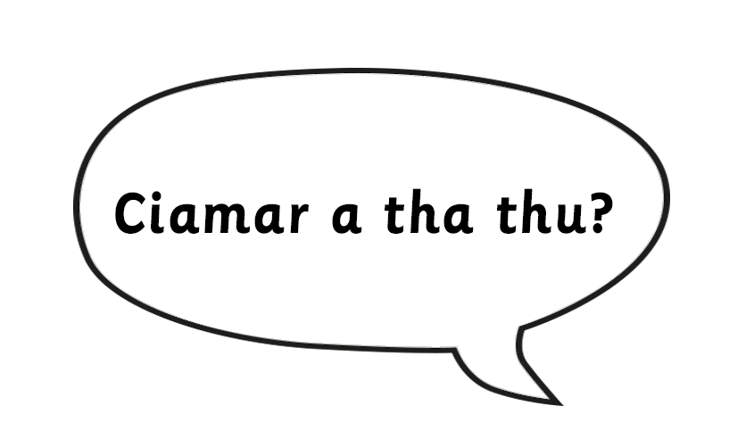

Tha gu math.
Notes:
How are you? I’m well.

Slide 2
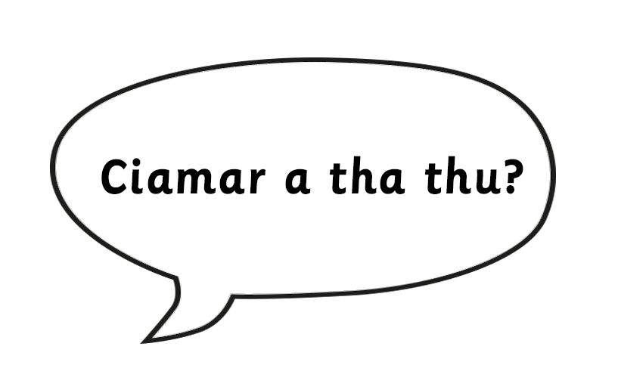
Tha mi sgìth.
Notes:
How are you? I’m tired.

Slide 3
Chan eil dona.
Notes:
How are you? Not bad.

Slide 4

Tha mi fuar.
Notes:
How are you? I am cold.

Slide 5
Tha mi teth.
Notes:
How are you? I am hot.

Slide 6
Tha mi trang.
Notes:
How are you? I am busy.

